Slide 1
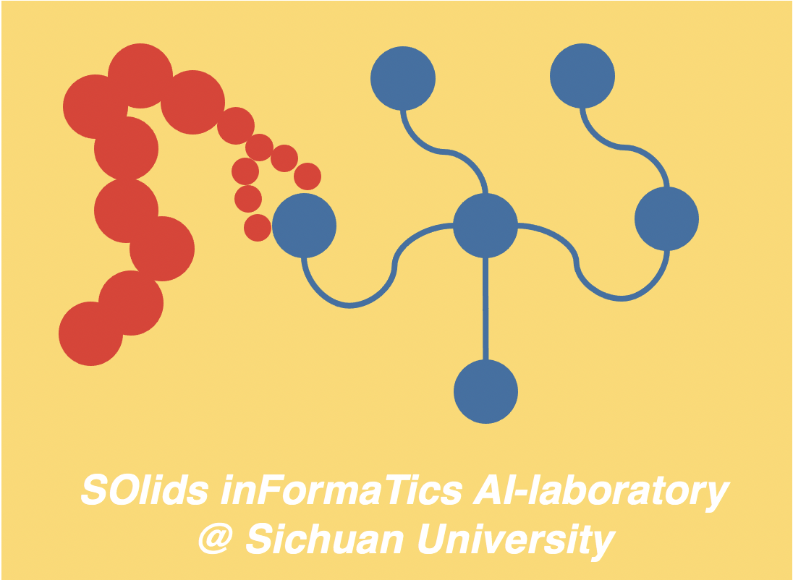
Soft talk:
Ai Computing for Solids Design
Han LIU (刘晗)
Sichuan University (SCU, CHINA)

Slide 2
Motivations

Slide 3
Methods

Slide 4
Results

Slide 5
Conclusions

Slide 6
THANK YOU!
Contact: happylife@ucla.edu
References:
[1]
Acknowledgements:

Slide 7

SOlids inFormaTics AI-laboratory
@ Sichuan University

